Slide 1
Little Paws
Pet Adoption
Web Application

Slide 2
Little Paws
Little Paws Web App is an online, searchable database of animals who need homes.

Slide 3
Abstract
Animal adoption is the process whereby a person brings an animal, mostly cats and dogs, to their own care.
These animals that are either lost or abandoned are taken by the animal control to be kept in animal shelters.

Slide 4
What it does?
The website is accessible for users and administrators where users can register themselves into the system to view the list of animals waiting to be adopted along with each animal’s records such as their age, gender, and their description.
The administrators are the main authority of the system and they are responsible for adding, editing, updating, and deleting information if necessary.

Slide 5
User Requirements
USER
To be able to register as a part of the system.
To be able to view the list of animals in the shelters and their basic information order to make decisions to adopt.
To be able to send messages or ask questions through the system.
ADMINISTRATOR
To be able to check the contact requests from the shelters from various cities
To be able to register a shelter from a particular city
To be able to create, update, delete and query the animal’s records in order to manage information.
Verify and approve users happy stories
Answer and upload the frequently asked questions

Slide 6
Objectives
The goal of this project is to develop a website for users to select animals to adopt conveniently as follows:
To develop a system that provides functions to support users to view the animals in the shelters conveniently.
To maintain records of animals in the shelters and the users information in a centralized database system.
To develop a system for administrators to be able to approve the user’s answers to the provided questionnaire.

Slide 7
Development Tools and Information

Slide 8

Front End Languages
HTML
CSS
Javascript

Slide 9


Back End Language
Web Framework
Python
Django

Slide 10


Database
Deployment
PostgreSQL
Heroku

Slide 11
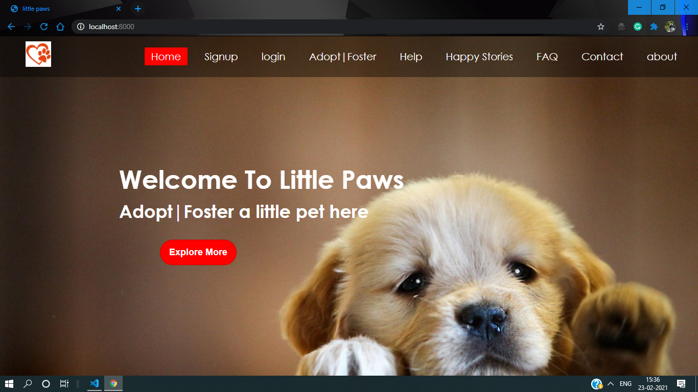
Desktop Project
A mockup of the web app in desktop gadget.

Slide 12
Be the kindest soul to adopt the needful souls!

Slide 13

Adopt!
Don’t shop

Slide 14
Done By,
Nivedha K
Kunguma Pooja J
Priyanka G

Slide 15
Thanks!

